Slide 1
Histogram
Histogram is a graph that shows frequency of anything. Histograms usually have bars that represent frequency of occuring of data.
Histogram has two axis: x and y.
The x axis contains the event whose frequency we count.
The y axis contains frequency.

Slide 2
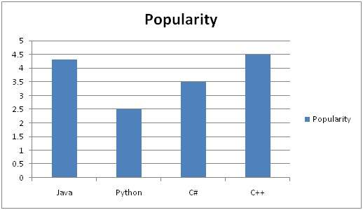
Histogram
Example of a typical histogram.

Slide 3

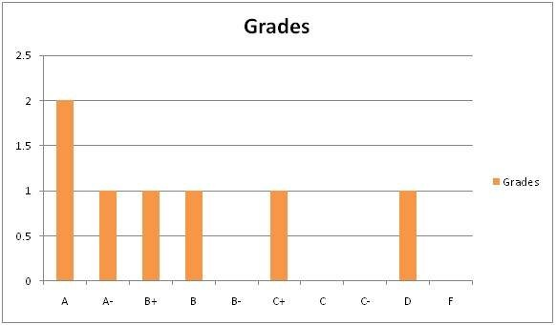
Histogram
Consider some students with their marks.

Slide 4
Image histogram
Image histogram shows frequency of pixel intensity values.
x axis shows the gray level intensities
y axis shows the frequency of intensities.

Slide 5
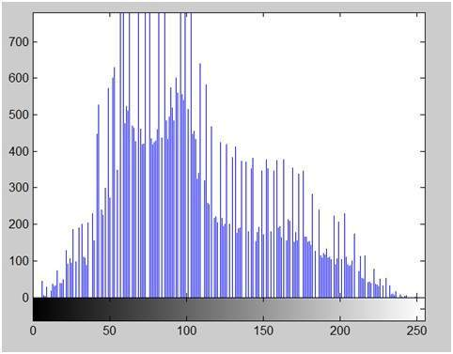
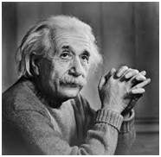
Image histogram
x axis – shows the range of pixel values.
For 8 bpp image, we have 256 levels of gray shades

Slide 6
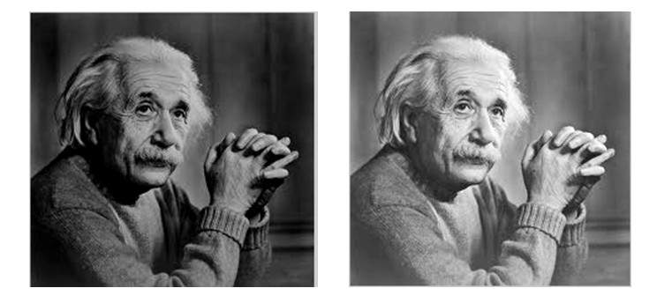
Brightness
Brightness is a relative term. It can be defined as the amount of energy output by a source of light relative to the source we are comparing to.
Image on the right is brighter than image on the left.

Slide 7

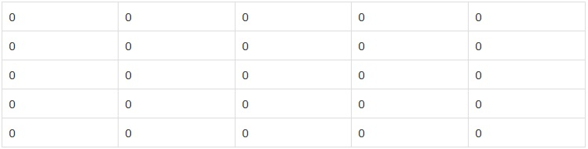
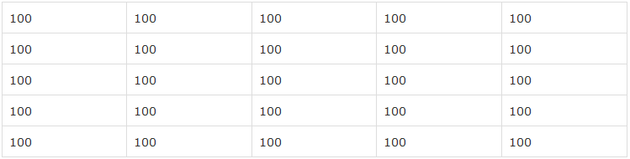

Brightness
Brightness can be easily increased or decreased by simple addition or subtraction to the image matrix

Slide 8
Contrast
The contrast of the image can be defined as the difference between maximum pixel intensity and minimum pixel intensity.
Max. int. = 0, Min. int. =0
Contrast = 0–0=0
Max. int. = 100, Min. int. =100
Contrast = 100–100=0

Slide 9
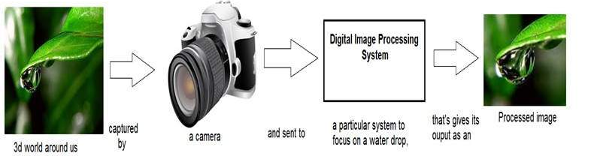
Image transformations
Transformation is a function. It maps one set to another set after performing some operations.
Digital Image Processing system performs the transformation.

Slide 10
Image transformation
Consider the equation
g(x,y)=T(f(x,y))
f(x,y) – input image, transformation is applied to this image.
g(x,y) – output image (processed image).
T is a transformation function.

Slide 11
Image transformation
The transformation can be also represented as
s=T(r)
r – pixel value of the input image f(x,y)
s – pixel value of the output image g(x,y)

Slide 12
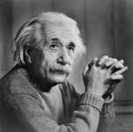
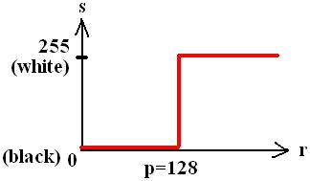
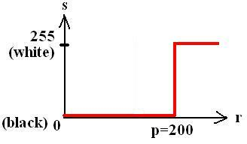
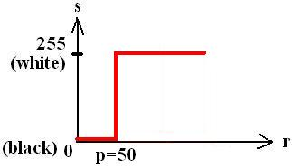
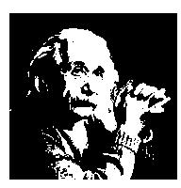
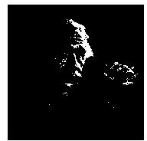
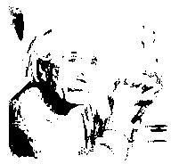
Image transformation
Original
image

Slide 13
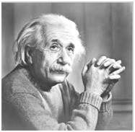
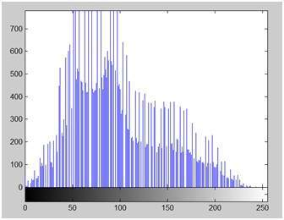
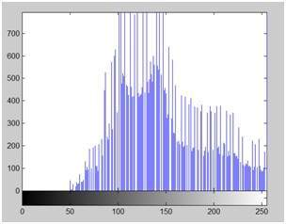
Histogram sliding
Brightness is changed by shifting the histogram to left or right.
+50

Slide 14
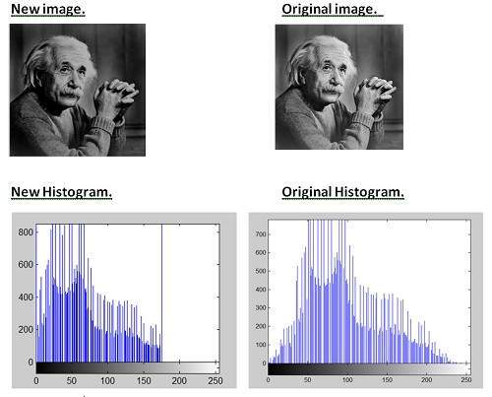
Histogram sliding
- 30

Slide 15
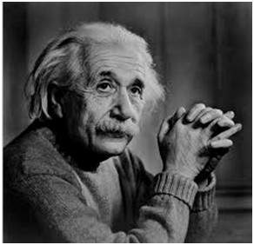
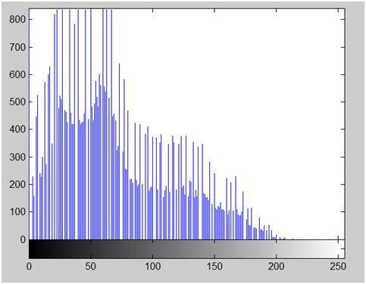
Histogram stretching
Contrast can be increased using:
1. Histogram stretching
2. Histogram equalization
Contrast is the difference between maximum and minimum pixel intensity. Contrast = 225.

Slide 16


Increasing the contrast
f(x,y)
g(x,y)
Low contrast image
High contrast image

Slide 17

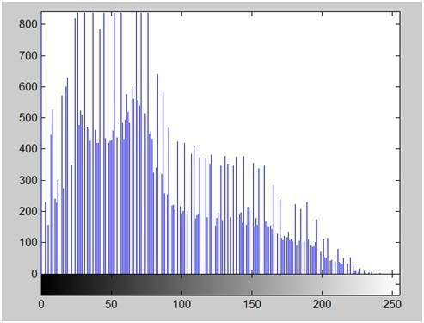
Contrast stretching
Before
Contrast = 225
After
Contrast = 240

Slide 18

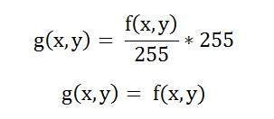
Contrast stretching
This formula doesn’t work always. If there is 1 pixel with intensity 255:
Contrast stretching has
no effect!!!

Slide 19
Introduction to probability
PMF and CDF are both related to probability. They will be used in Histogram Equalization.
PMF – Probability Mass Function.
It gives the probability of each number in the data set (frequency of each element).

Slide 20
Probability – PMF
Calculating PMF from image matrix
PMF
Image matrix
1 2 7 5 6
7 2 3 4 5
0 1 5 7 3
1 2 5 6 7
6 1 0 3 4
0 | 2 | 2/25
1 | 4 | 4/25
2 | 3 | 3/25
3 | 3 | 3/25
4 | 2 | 2/25
5 | 4 | 4/25
6 | 3 | 3/25
7 | 4 | 4/25

Slide 21
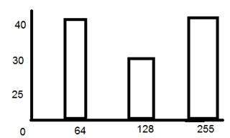
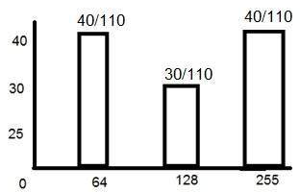
Probability – PMF
Calculating PMF from histogram
Frequency of gray level values for an 8 bits per pixel image.
Not monotonically increasing function

Slide 22
Probability – CDF
CDF – Cumulative Distributed Function
Cumulative sum of values calculated by PMF

Slide 23
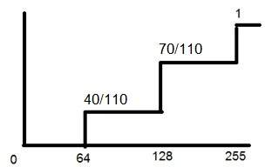
Probability – CDF
CDF will be calculated using the histogram
CDF makes the PDF grow monotonically
Monotonical growth is necessary for histogram equalization.

Slide 24
Histogram equalization
Histogram equalization is used for enhancing the contrast of the images.
The first two steps are calculating the PDF and CDF.
All pixel values of the image will be equalized.

Slide 25
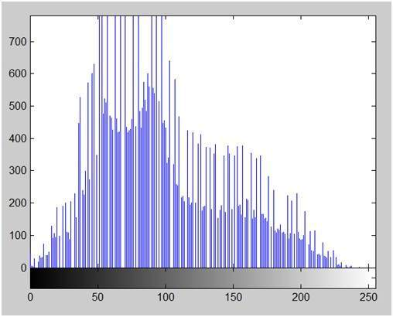
Histogram equalization
Image with its histogram

Slide 26

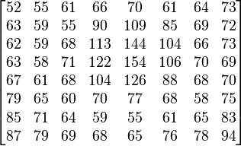
Histogram equalization
Small image (values)
Small image (values)

Slide 27
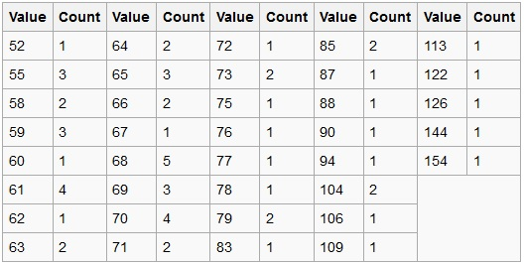
Histogram equalization
Image detail
Frequency of pixel values

Slide 28
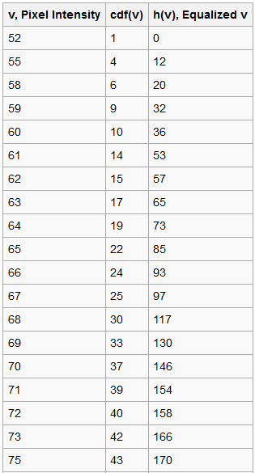
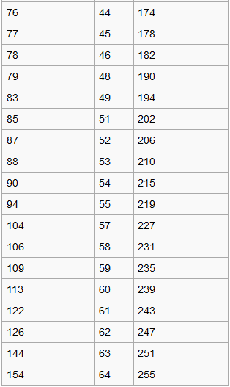
Histogram equalization

Slide 29


Histogram equalization
min = 52
max = 154
cdf_{min} is the minimum non-zero value of the cumulative distribution function (in this case 1), M × N gives the image's number of pixels (for the example above 64, where M is width and N the height) and L is the number of grey levels used (in most cases, like this one, 256).

Slide 30
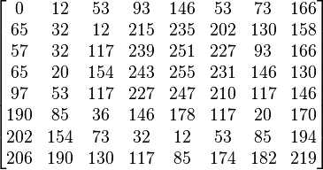


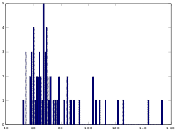
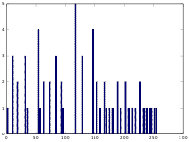
Histogram equalization
New min. value = 0, old min. value 52
New max. value = 255, old max. value 154
Original
Equalized

Slide 31
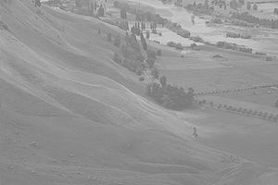
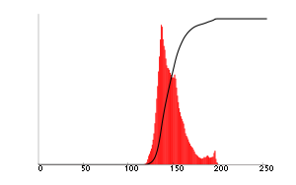
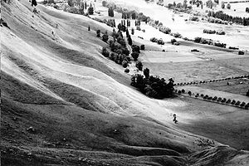
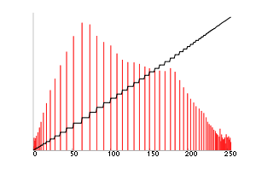
Histogram equalization
An unequalized image
Corresponding histogram (red) and cumulative histogram (black)
The same image after histogram equalization
Corresponding histogram (red) and cumulative histogram (black)

Slide 32

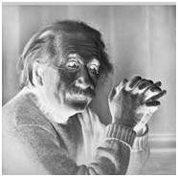
Negative transformation
Original
Negative
s = (L – 1) – r

Slide 33
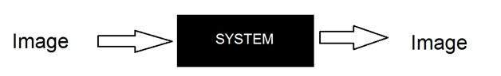
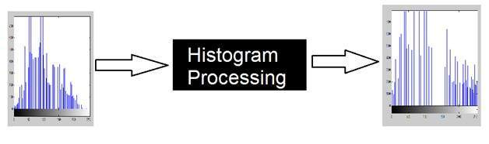
Concept of convolution
Black box

Slide 34
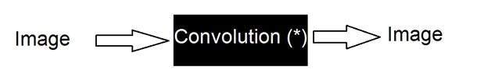
Concept of convolution
g(x,y) = h(x,y) * f(x,y) mask convolved with an image
g(x,y) = f(x,y) * h(x,y) image convolved with mask
The convolution operator (*) is commutative, h(x,y) is the mask or filter.

Slide 35
Convolution mask
Mask is a matrix, usually of size 1x1, 3x3, 5x5 or 7x7 (odd number).
Convolution steps:
  Flip the mask horizontally and vertically
  Slide the mask onto the image
  Multiply the corresponding elements and add them
  Repeat this until all image values are calculated

Slide 36


Convolution example
Mask:
After flipping the mask:

Slide 37

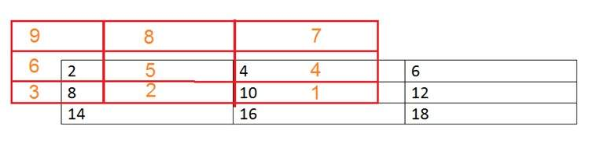
Convolution example
Image matrix
Place the mask over each image element. Multiply the corresponding elements and add them

Slide 38
Convolution example
Red – mask, black – image
First pixel: = (5*2) + (4*4) + (2*8) + (1*10)
= 10 + 16 + 16 + 10
= 52
Convolution can achieve blurring, edge detection, sharpening, noise reduction, etc

Slide 39

Concept of mask
A mask is a filter. Concept of masking is a concept of spatial filtering.
Sample mask
Filtering is convolving a mask with an image by moving the center of the mask over each image pixel.

Slide 40
Filters
Filters are used for:
- blurring
- noise reduction
- image sharpening
- edge detection

